Slide 1
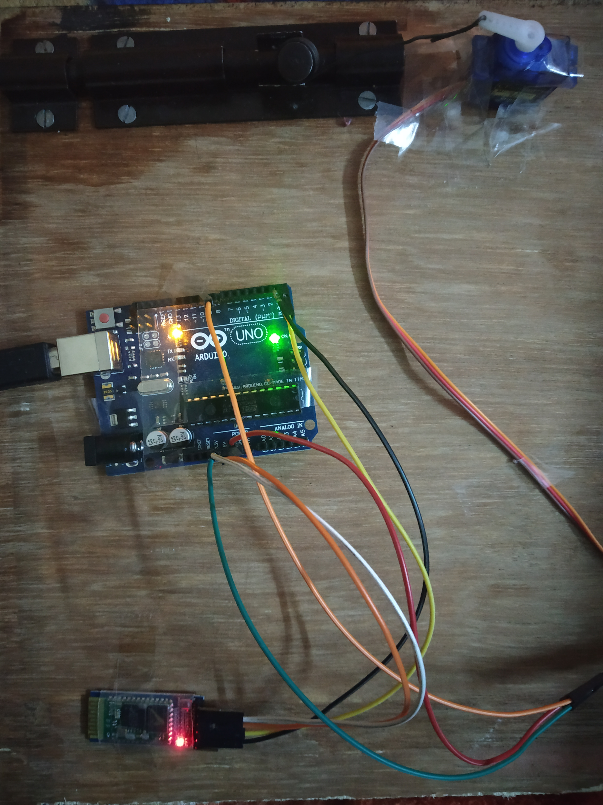
SMART DOOR LOCK

Slide 2
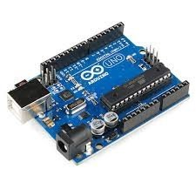
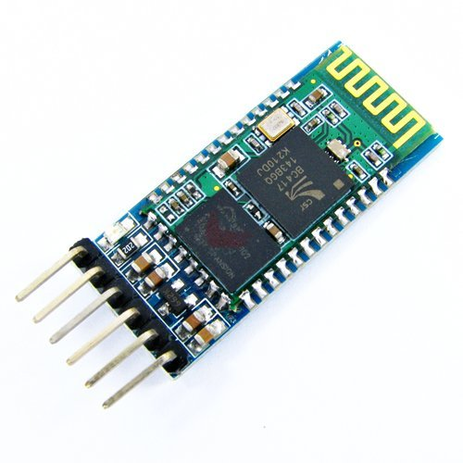
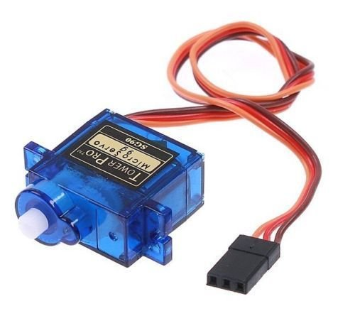
COMPONENTS USED:-
Arduino UNO R3
Bluetooth Module HC-05
Servo Motor SG90 9g
Jumper Wires
Lock

Slide 3
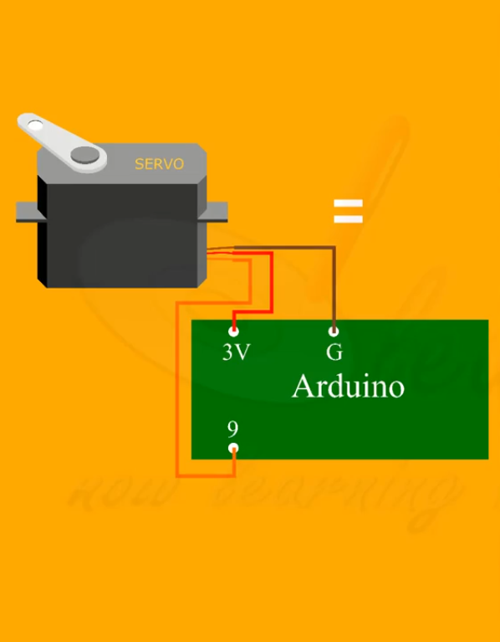
Connecting Servo motor with arduino

Slide 4
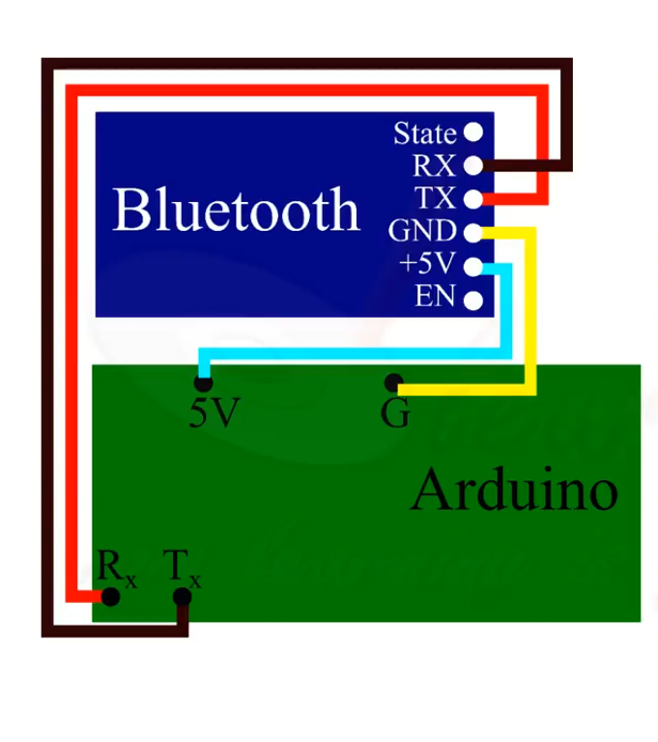
CONNECTING Bluetooth module with Arduino:-

Slide 5
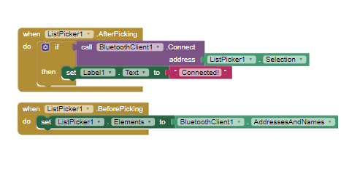
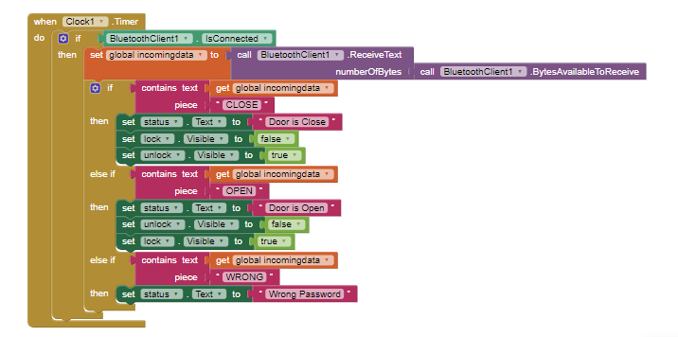
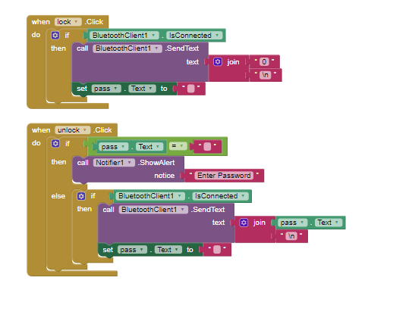
App code

Slide 6
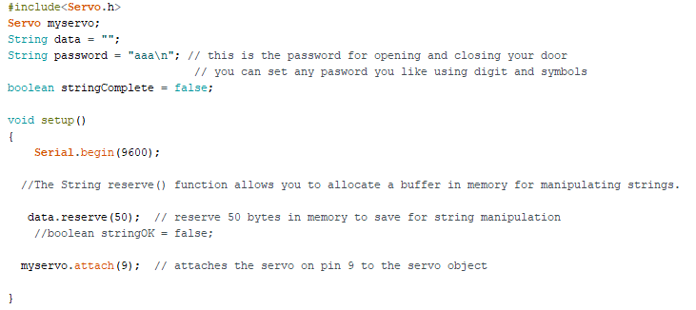
Code:-

Slide 7
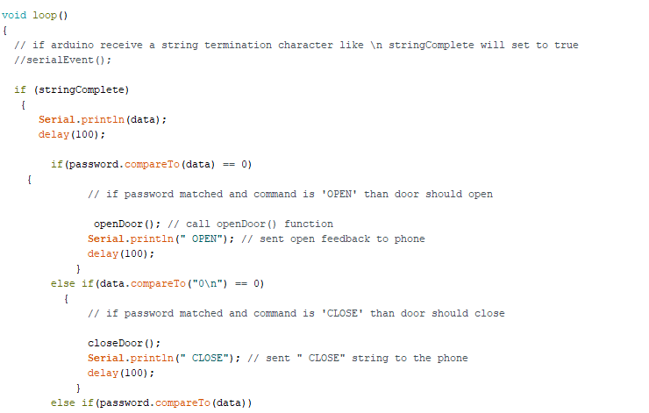

Slide 8
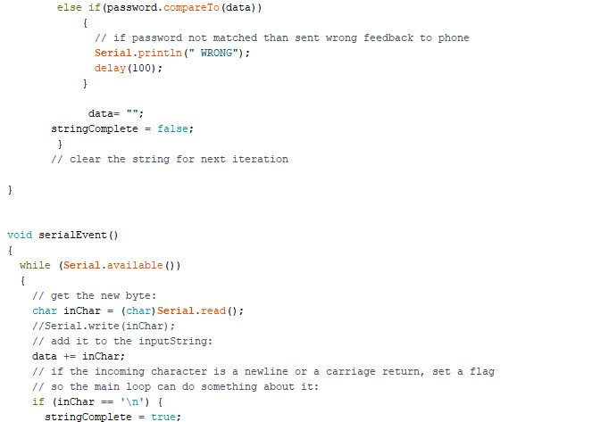

Slide 9
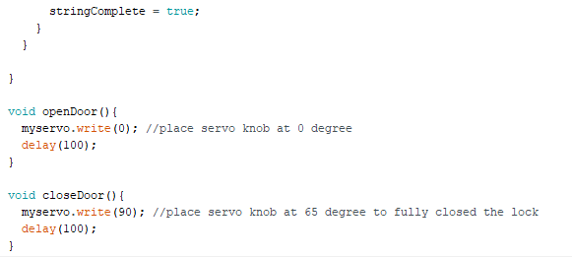

Slide 10
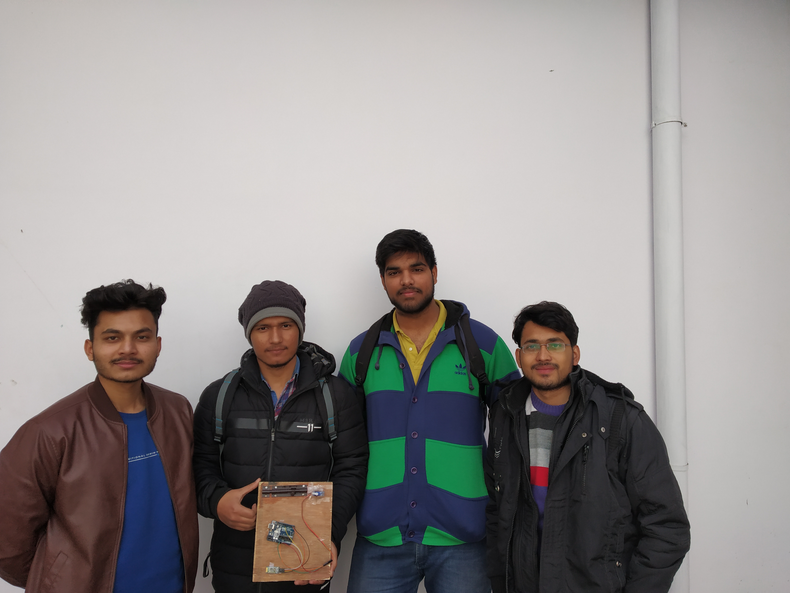
Invented by:-
Pulkit Gupta
Aviral Kandari
Amit Kashyap
Aksh Rawat

Slide 11
THANk YOU.

